Slide 1
Java 4 WEB
Lesson 4 – Home tasks overview

Slide 2
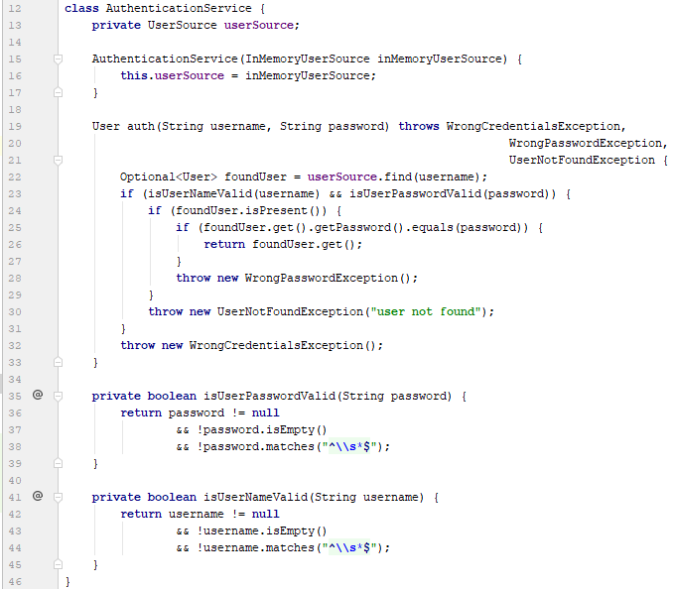
1. Do not declare unchecked exceptions

Slide 3
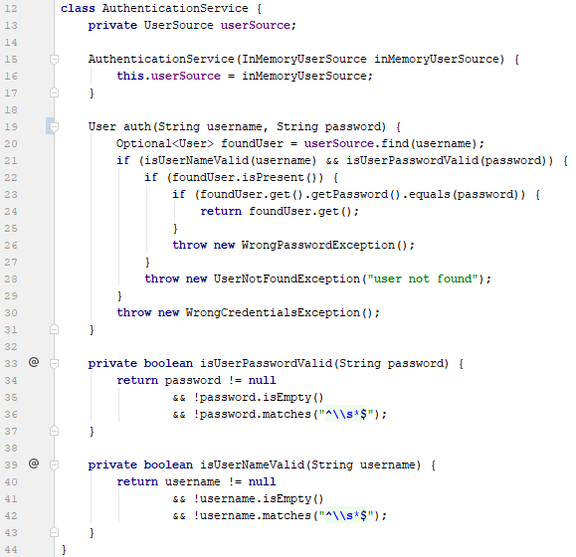
1. Do not declare unchecked exceptions

Slide 4
2. Prefer abstractions

Slide 5
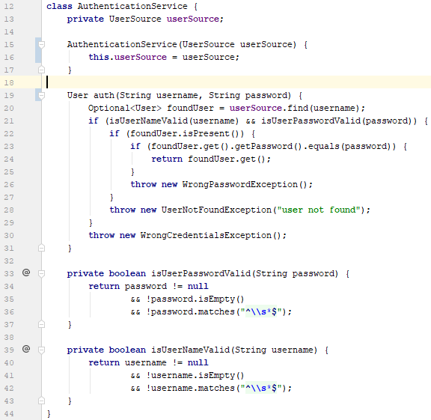
2. Prefer abstractions

Slide 6
3. Method name should describe purpose

Slide 7
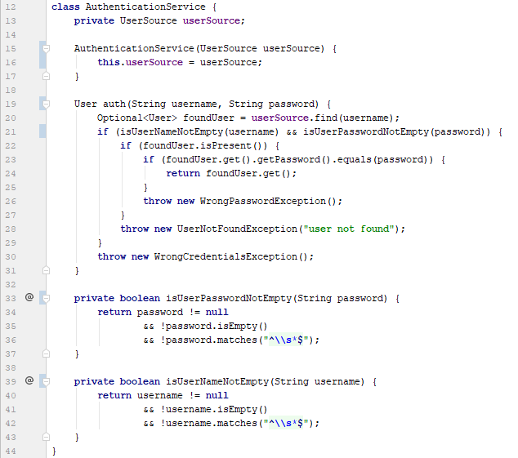
3. Method name should describe purpose

Slide 8
4. Do not repeat your self

Slide 9
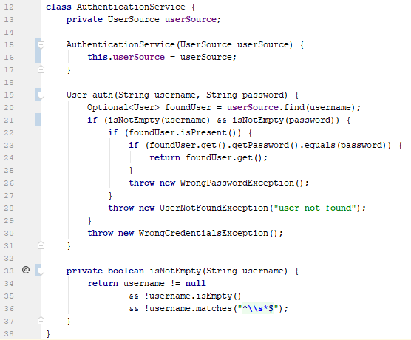
4. Do not repeat yourself

Slide 10
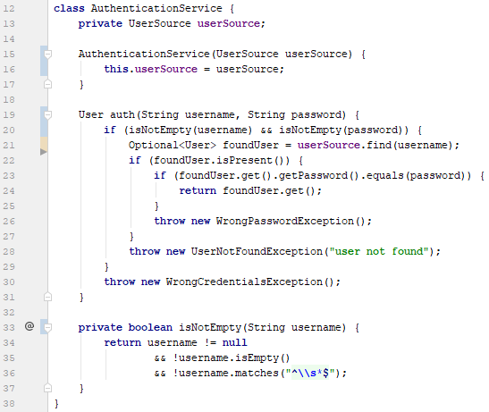
5. Do not make extra operations
Notes:
Invoke db only after validation

Slide 11
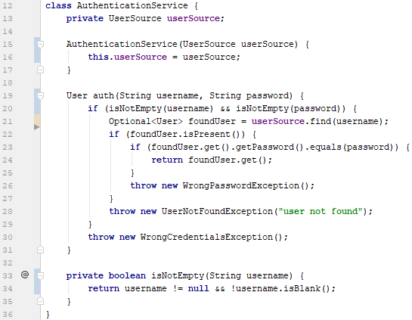
5. Do not make extra operations

Slide 12
6. Do not make >2 inner blocks

Slide 13
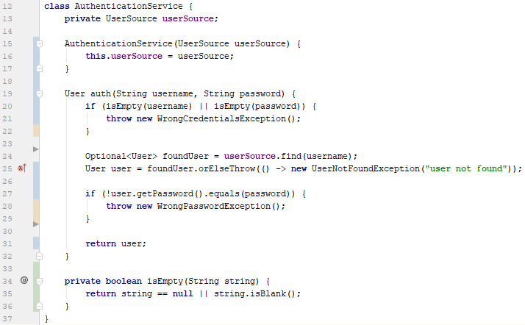
6. Do not make >2 inner blocks

Slide 14
7. Do not duplicate error info

Slide 15
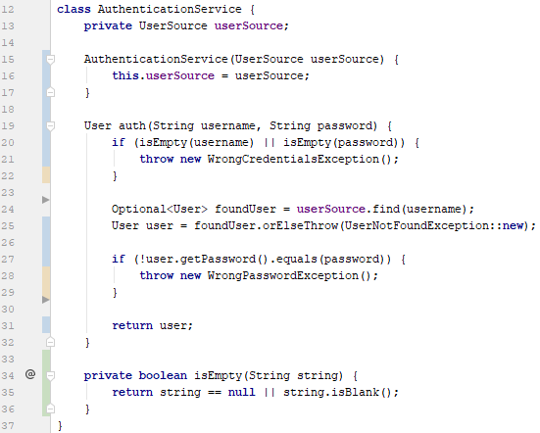
7. Do not duplicate error info

Slide 16
8. Reuse code

Slide 17
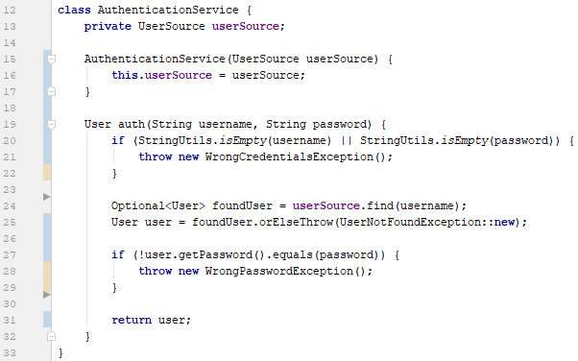
8. Reuse code

Slide 18
8 Before and After

Slide 19
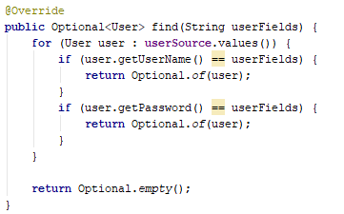
9. Wrong user lookup
Notes:
Why user is retrieved by password?

Slide 20
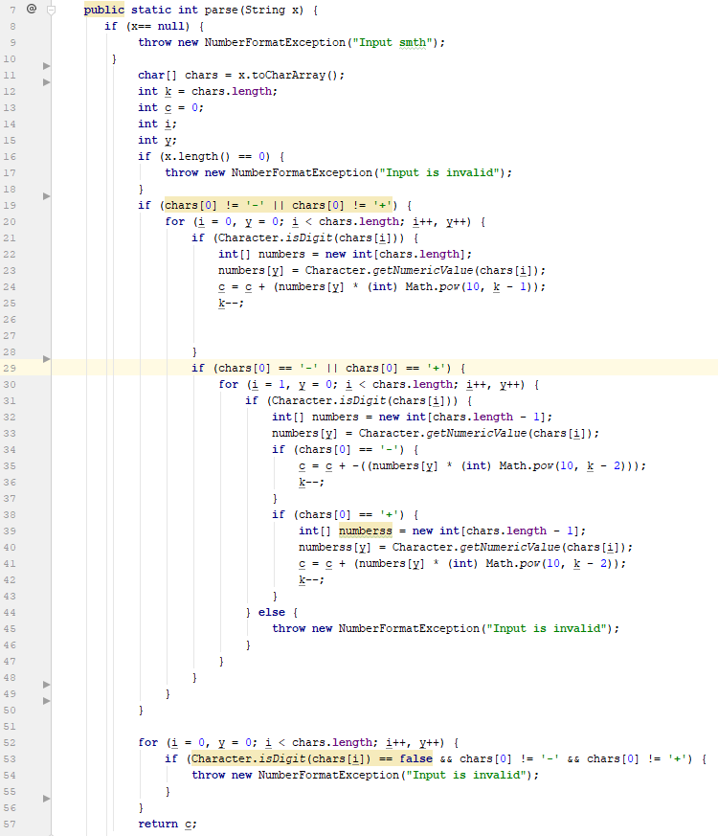
10. Bad big code
Notes:
Who can guess where is the sign check?

Slide 21

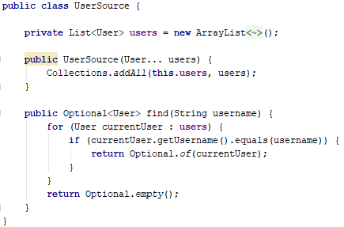
11. Do not inherit user source
Notes:
Avoid inheritance
Prefer composition

Slide 22
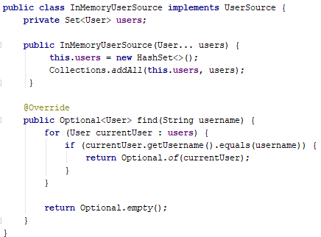

11. Do not inherit user source

Slide 23
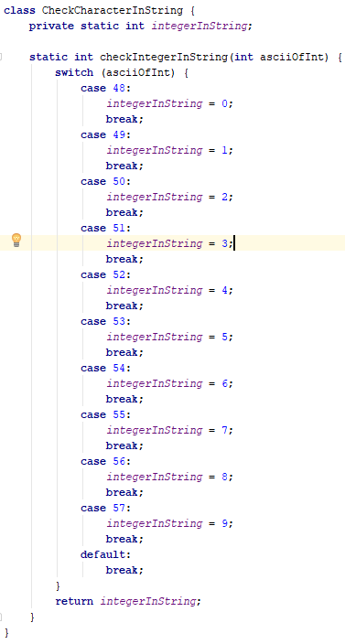
12. Use built-in code

Slide 24
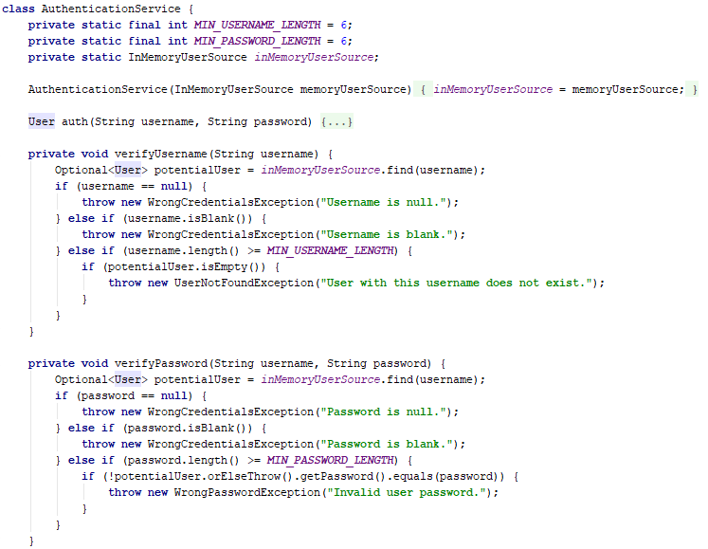
13. Do not implement extra code

Slide 25
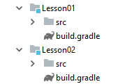
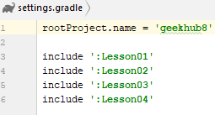
14. Add Gradle support in lesson 01/02

Slide 26
15. Better commit messages
L04-T1 Implement InMemoryUserSourceTest
L04-T1 Implemented Number parser test
L04-T1 Changed logic of method
L04-T2 "working task"

